Slide 1

DATA ANALYTICS
AN INTRODUCTION

Slide 2
What is Data?
Since the invention of computers, people have used the term data to refer to computer information, and this information was either transmitted or stored. But that is not the only data definition; there exist other types of data as well.
So, what is the data? Data can be texts or numbers written on papers, or it can be bytes and bits inside the memory of electronic devices, or it could be facts that are stored inside a person’s mind.
Information is defined as classified or organized data that has some meaningful value for the user. Information is also the processed data used to make decisions and take action. Processed data must meet the following criteria for it to be of any significant use in decision-making:
Accuracy: The information must be accurate.
Completeness: The information must be complete.
Timeliness: The information must be available when it’s needed.

Slide 3
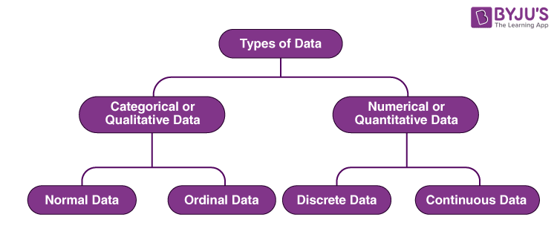
Types of Data
There are different types of data in Statistics, that are collected, analysed, interpreted and presented.

Slide 4
Types of Data
Qualitative data, also known as the categorical data, describes the data that fits into the categories. Qualitative data are not numerical. The categorical information involves categorical variables that describe the features such as a person’s gender, home town etc.
Nominal data is one of the types of qualitative information which helps to label the variables without providing the numerical value. Nominal data is also called the nominal scale. It cannot be ordered and measured. But sometimes, the data can be qualitative and quantitative. Examples of nominal data are letters, symbols, words, gender etc. The nominal data are examined using the grouping method. In this method, the data are grouped into categories, and then the frequency or the percentage of the data can be calculated. These data are visually represented using the pie charts..
Ordinal data/variable is a type of data that follows a natural order. The significant feature of the nominal data is that the difference between the data values is not determined. The ordinal data is commonly represented using a bar chart. These data are investigated and interpreted through many visualisation tools. The information may be expressed using tables in which each row in the table shows the distinct category.

Slide 5
Types of Data
Quantitative data is also known as numerical data which represents the numerical value (i.e., how much, how often, how many). Numerical data gives information about the quantities of a specific thing.
Discrete data can take only discrete values. Discrete information contains only a finite number of possible values. Those values cannot be subdivided meaningfully. Here, things can be counted in whole numbers.
Continuous data is data that can be calculated. It has an infinite number of probable values that can be selected within a given specific range.

Slide 6
Introduction to Data Analytics
Organizations can collect and process vast amounts of data. This data is collected from an increasing range of sources - for example, mobile devices, online platforms, payment systems, cameras, GPS systems, wireless sensors, and legacy systems. And this business data is stored in a wide variety of formats.
A Data source is where data is collected from, there are different data sources as listed above.

Slide 7
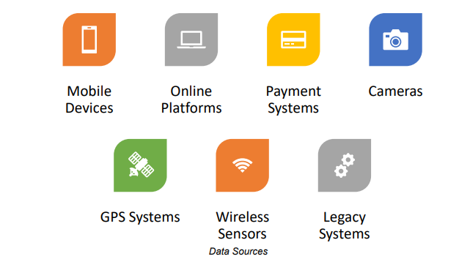
Data Sources

Slide 8
Data Analytics’ Definition and Uses
Data analytics refers to the techniques and processes used to collect, organise and examine data sets to create meaningful and useful information.
In recent times there has been a rapid rise in the use of data analytics across all types of organizations and sectors due to, among other things, technological advances in data analytics, increased computing power and better data storage capabilities. The use of data analytics can provide many benefits – for example, in business it can be used to gain competitive advantage, improve performance and increase profits.

Slide 9
Category of Data Analytics
There are different categories and types of data analytics, which although interrelated, have different purposes and provide different insights. In business deciding which type of data analytics is appropriate depends on a variety of factors, such as, the type of data being used, the stage of the workflow and your business requirements and objectives.
There are two broad categories of data analytics and they are:
Qualitative Data Analytics: can be used to analyze information about attitudes, opinions and behaviors. This type of information is not easily measured or expressed as numbers – examples include, customer’s opinions on a product or service, opinions on an organization's reputation or attitudes towards a brand. This uses unstructured or semi-structured techniques to gather data such as, focus groups, discussions, interviews and observations.
Quantitative Data Analytics: can be used to analyze information that can be measured and written down with numbers e.g. information like profits, costs, sales, number of repeat Purchase. This uses structured techniques to gather data, such as surveys, business reports and polls. And it uses mathematical and statistical methods to analyze the data gathered. .

Slide 10
Types Of Data Analytics
There are four types of data analytics based on their functions and uses:
Descriptive Data Analytics: This is used to find out what happened in the past. it provides valuable insights into the past by summarizing raw or historical data from multiple data sources. Descriptive analytics uses descriptive statistics, such as arithmetic operations, mean, median, and percentage.
Diagnostic Data Analytics: Diagnostic analytics are used to find out why something happened in the past? It takes a deeper look at the data to understand the root causes of events and to determine the factors that contributed to the outcome. Diagnostic analytics use techniques such as drill-down, data discovery, and correlations. And it uses probabilities, likelihoods, and the distribution of outcomes for the analysis.

Slide 11
Types Of Data Analytics
Predictive Data Analytics: Predictive analytics are used to find out what is likely to happen in the future? It uses the findings of descriptive and diagnostic analytics to forecast the probability of a future outcome. The forecast is an estimate, the accuracy of which depends on the quality and constancy of the data. Predictive analytics use techniques such as modelling to devise statistical or mathematical models of current and historical data.
Prescriptive Data Analytics: Prescriptive analytics are used to identify what is the best action to take now? It is useful for avoiding problems that may arise in the future or for making the best use of trends. It is a relatively new and complex type of analytics. Prescriptive analytics use the findings of predictive analytics combined with historical and transactional data, real-time data feeds from both internal and external sources, mathematical models and various business rules. Techniques include optimisation, simulation, and decision-analysis methods.

Slide 12
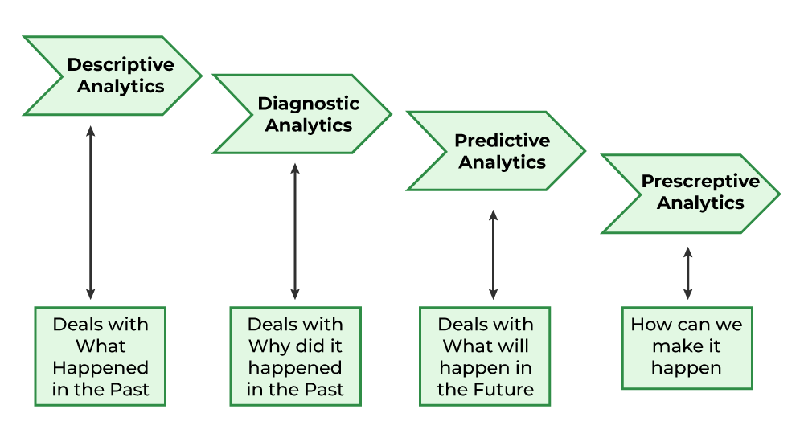
Types of Data Analytics

Slide 13
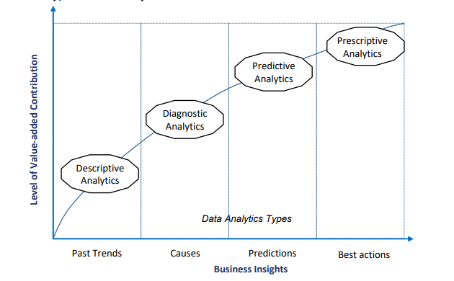
This shows the level of value added contribution each type of data analytics gives to a company. As we can see, the prescriptive data analytics shows the highest level.

Slide 14
Business Benefits using Data Analytics
The insights gained from data analytics can provide businesses with the following benefits:
Identifying patterns/trends: The process of evaluating large sets of data containing varying data types can help businesses to uncover hidden patterns in the data.
Improving efficiency: The insight gained by data analytics enables businesses to automate and optimize their business processes thus improving operational efficiency.
Supporting decision making: Access to large volumes of analysed data allows businesses to make better and more informed business decisions and to set more effective business strategies.
Presenting information effectively: Data presented in easy-to-understand formats such as tables, charts, maps, and graphs help businesses to better interpret and understand their data.

Slide 15
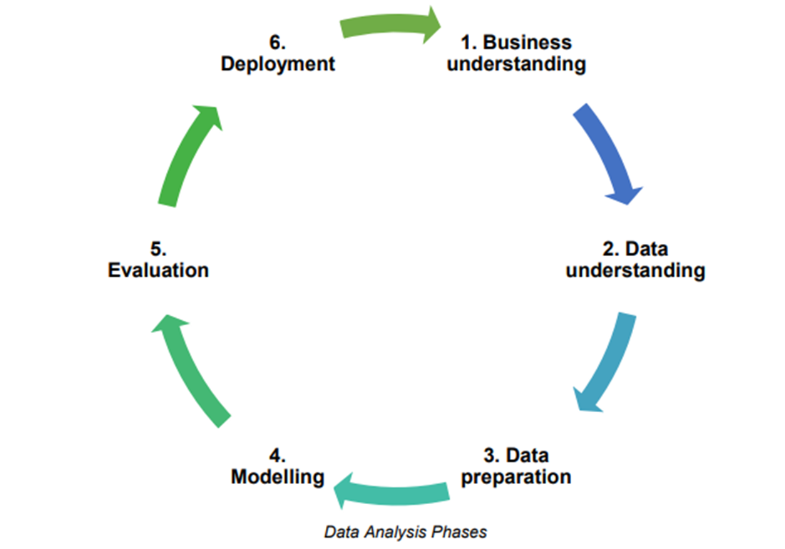
Data Analysis Process
The data analysis process and phases will vary depending on the type of data analytics used and your business implementation. It can include tasks such as defining the question you are trying to answer; deciding what data you need to answer the question; determining if you have the data; collecting the data; getting the data ready for analysis (cleaning and transforming the data); analysing the data; interpreting the results; and using the results.

Slide 16
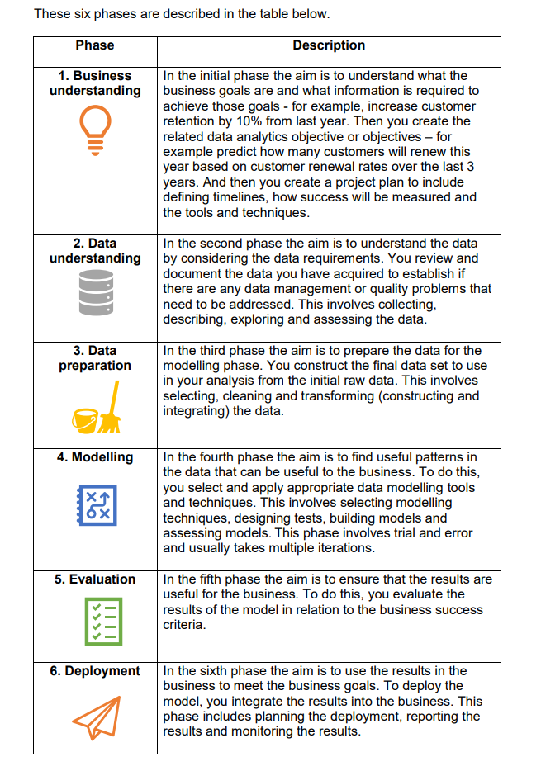

Slide 17
Data Protection Considerations
Data protection is an area of law that is designed to protect the privacy rights of individuals in relation to the processing of their personal data.
Personal data is typically defined as data that contains identifiers that can be used to identify an individual.
Data protection laws govern how organizations use personal data and need to be complied with when analyzing data that contains personal data.

Slide 18
Sampling
The sample is the group of individuals who will actually participate in the research.
The population is the entire group that you want to draw conclusions about. The population can be defined in terms of geographical location, age, income, or many other characteristics.
The sample is the specific group of individuals that you will collect data from.

Slide 19
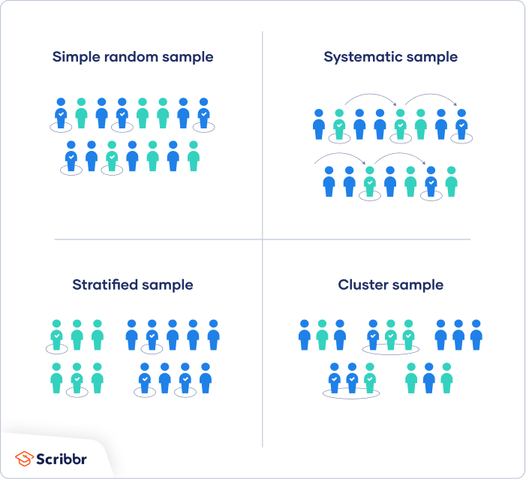
Types Of Sampling
There are four main types of probability sample.

Slide 20
Types of Sampling
Simple Random Sampling: In a simple random sample, every member of the population has an equal chance of being selected. Your sampling frame should include the whole population. To conduct this type of sampling, you can use tools like random number generators or other techniques that are based entirely on chance.
Systematic Sampling: Systematic sampling is similar to simple random sampling, but it is usually slightly easier to conduct. Every member of the population is listed with a number, but instead of randomly generating numbers, individuals are chosen at regular intervals. All employees of the company are listed in alphabetical order. From the first 10 numbers, you randomly select a starting point: number 6. From number 6 onwards, every 10th person on the list is selected (6, 16, 26, 36, and so on), and you end up with a sample of 100 people.
Stratified Sampling :This involves dividing the population into subpopulations that may differ in important ways. It allows you draw more precise conclusions by ensuring that every subgroup is properly represented in the sample. To use this sampling method, you divide the population into subgroups based on the relevant characteristic (e.g., gender identity, age range, income bracket, job role). Then you use random or systematic sampling to select a sample from each subgroup..

Slide 21
Types Of Sampling
Cluster Sampling: Cluster sampling also involves dividing the population into subgroups, but each subgroup should have similar characteristics to the whole sample. Instead of sampling individuals from each subgroup, you randomly select entire subgroups.
If it is practically possible, you might include every individual from each sampled cluster. If the clusters themselves are large, you can also sample individuals from within each cluster using one of the techniques above. This is called multistage sampling.

